Slide 1
Notes:
Input and change of text and/or images
Select a textbox
Type or copy/paste your story
IMPORTANT: Pasting text should be done with unformated text (On Home tab use the Paste pulldown and choose Paste special… than choose Unformated text)
On Mac: Command + Control + V than choose unformated text
On Windows: On Home tab use the Paste pulldown and choose Paste special… than choose Unformated text (https://nutsandboltsspeedtraining.com/powerpoint-tutorials/paste-special-powerpoint/)
Select your text
Press ‘Tab’ on your keyboard to go to the next preset text style. We have 9 different styles on regular Text placeholders (Heading placeholders are always in 1 style)
Subheading QuickSand Bold blue 32 / 42 pt
Subheading QuickSand Bold turquoise 32 / 42 pt
Subheading QuickSand Bold white 32 / 42 pt
Body text Muli Light blue 28 / 38 pt
Body text Muli Light white 28 / 38 pt
Bullet Muli Light blue 28 / 48 pt
Bullet Muli Light white 28 / 48 pt
Quote QuickSand Regular turquoise 34 / 40 pt
Quote QuickSabd Regular white 34 / 40 pt
Press ‘Shift Tab’ to go to the previous style!
Change footer presentation name by going to the Insert tab, than choose Header & Footer, than check footer, and fill your title. Press Apply to all!
Change presentation date by going to the insert tab, than choose Date & Time, than check date & time, choose format. Press Apply to all! (Date is only present on presentation title slide, uncheck in Date & Time if you do not want a date on this slide!)
On many pages you can change the background image (i.e.Presentation slide): format background: insert image from file. Choose your picture from the Assets folder!
On content slides with a visual: change the default visual: format background: insert image from file (assets folder). Choose your picture! Possible change position by changing the offset percentages

Slide 2
CI/CD
Making your life easy

Slide 3



Trainingsdoelen
“It’s gonna be legen - wait for it - dary.” Barney Stinson
De kernconcepten en het nut van CI & CD begrijpen
Comfortabel worden met het opzetten/aanpassen van de CI/CD pipeline in je projecten
Een kant-en-klare pipeline opzetten (hands-on) die je kunt gebruiken in je projecten

Slide 4
Programma
“It’s gonna be legen - wait for it - dary.” Barney Stinson
Dag 1
Wat is CI/CD?
Continuous Integration (CI)
Continuous Delivery / Deployment (CD)
Tools
Hands-on
Dag 2
Hands-on
Wrap-up

Slide 5
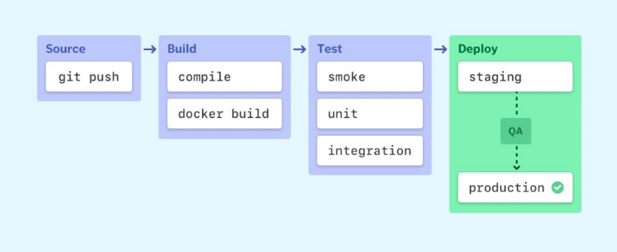
Wat is CI/CD?
Wat?
CI/CD is een `way-of-working` met als doel de stappen die nodig zijn van development tot aan de operatie zoveel mogelijk te automatiseren
“CI/CD bridges the gaps between development and operation activities by enforcing automation in building, testing and deployment of applications.”
Waarom?
Minder handmatige taken -> Sneller + Minder fouten
Hoe?
CI/CD pipeline

Slide 6
Wat is CI/CD?
CI/CD komt uit de software-engineering wereld
Populair geworden bij de switch van Waterval naar Agile werken
De kern is snel en iteratief kunnen deployen
Een CI/CD pipeline is geen magisch instrument
CI/CD is een manier van werken en dus meer dan alleen een pipeline die code test.
Werkafspraken zijn net zo belangrijk als een goed functionerende pipeline (zie volgende slide)

Slide 7
CI/CD fundamentals
Single source repository
Quite obvious, just use GitHub/GitLab
Frequent check-ins to main branch
Merge often and merge nothing more than 1 change at a time
Automated builds
CI process should automatically package/compile the code into the application
Self-testing builds
Ensure that: A failed test == A failed build
Frequent iterations
See #2; easy to roll back changes if
Stable testing environments
Tests should always be run in an environment identical to production
Maximum visibility
Every dev should be able to access the latest version of the software (see #1)
Predictable deployments anytime
Deployments should be routine & low-risk so everyone in the team is comfortable with it.

Slide 8
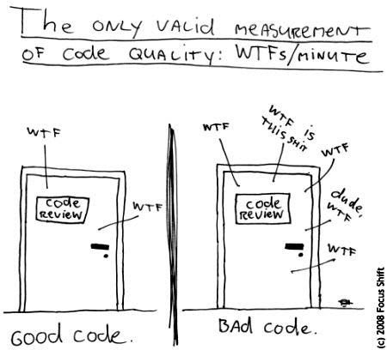
Continuous Integration
“CI is the practice of integrating all your code changes into the main branch of a shared source code repository early and often, automatically testing each change when you commit or merge them and automatically kicking off a build.”
Responsibility
Team | CI pipeline
Write proper code that complies with linting rules (or use black…) | Check linting (or apply black…)
Write proper tests that make sense | Run tests
Merge frequently to main | Build (e.g. a Docker container)
Merging one change at a time
Check failure/success of the CI pipeline
Tip: Robert C. Martin - Clean Code

Slide 9

Continuous Integration
Richtlijn: Een CI process zou niet langer moeten duren van 10 minuten
Bij een trage CI-pipeline worden dev’s defensief en houden ze changes langer op hun lokale machine → Hierdoor zijn er potentieel meer merge conflicts.
Bij een trage CI-pipeline gaan dev’s context wisselen -> Is moeilijk en kost energy
Tip (voor zover nog niet bekend)
Investeer tijd in je lokale setup met als doel: minimaliseren van failing pipelines
Gebruik een makefile & pre-commit die de remote CI-pipeline nabootst, voor snellere development

Slide 10
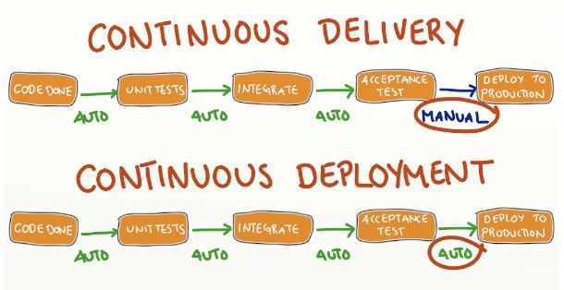
Continuous Delivery / Deployment
Automatisch deployen van applicaties (vaak) zonder handmatige interventie
Soms kan handmatig testen nuttig nog steeds nuttig zijn (e.g. front-end/QA checks)
Terminologie vaak door elkaar gebruikt
Delivery: e.g. software deliverable die ready is om naar productie gepusht te worden
Deployment: e.g. deploy new code on cluster

Slide 11
CI/CD Tools
Overview + GitHub Actions

Slide 12

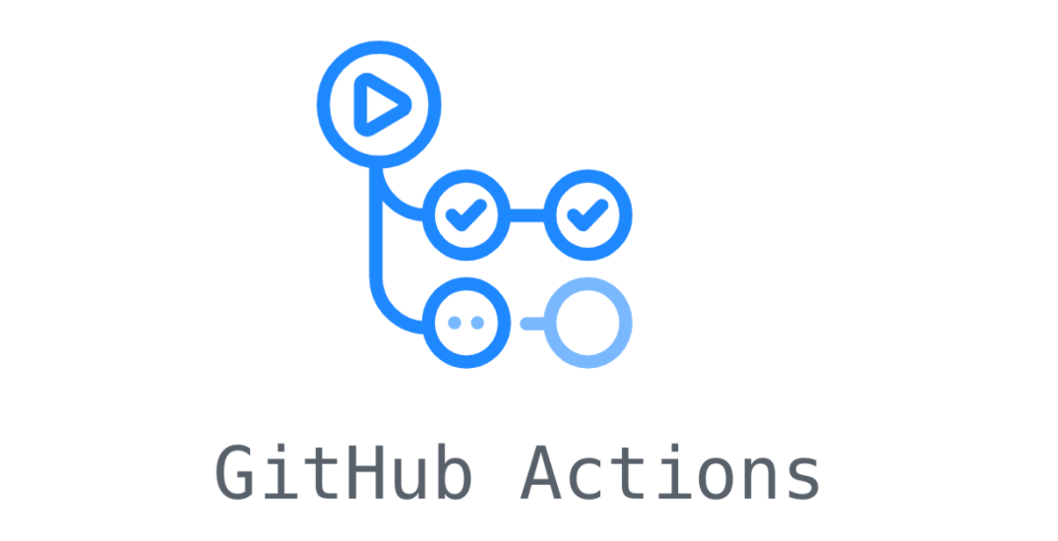

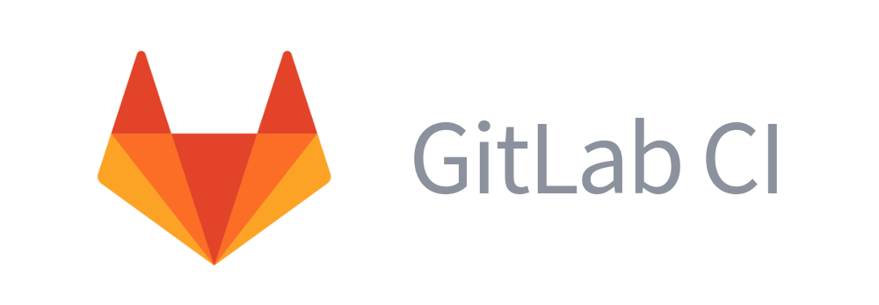


Tools

Slide 13
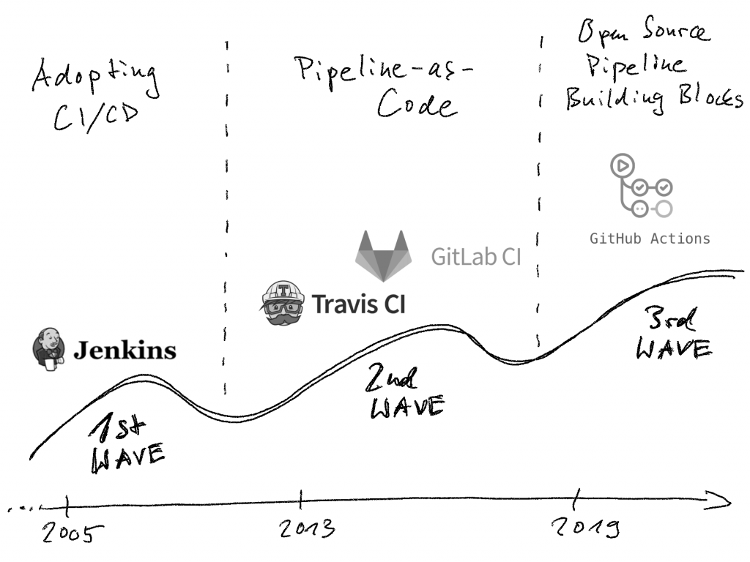
Tools
Notes:
Jenkins: Open Source en oldest in town. Need own server to host Jenkins. Switched to the Pipeline-as-code as we know it at the moment, but “missed the boat” according to many peepz on the interwebs. Main pro is that it has a lot of plugins as it is open source. So many active developers working on it.
Travis CI: Not open source, but easy to use. Register your project at travis-ci website and add a `.yml` to your git repository. Will work out of the box.
GitLab CI == GithubActions: Simple and declarative. Main pro is that it is directly integrated with your repository, so no other website/dashboards to look at.
GitLab CI/ GItHub Actions is preferred choice if working at one of the two and if you want to set something up quick. Jenkins can be a bit better if you have a lot of repo’s and want more oversight in the jobs on different repo’s
GitHub Actions has a marketplace.

Slide 14
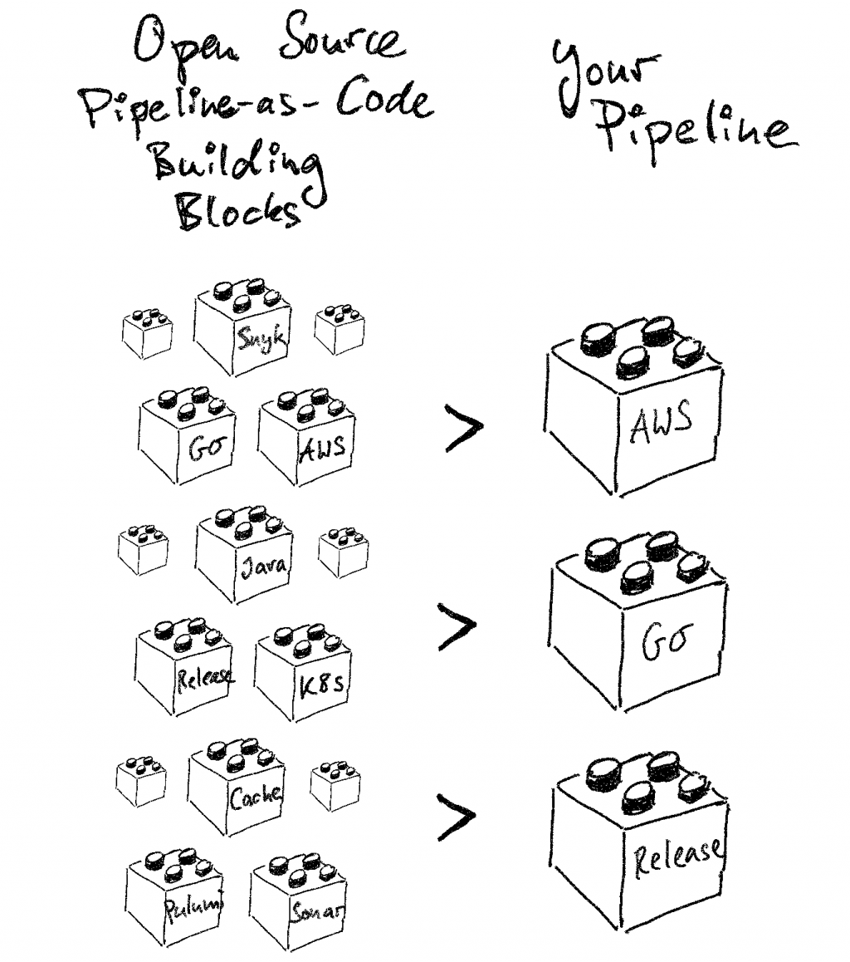
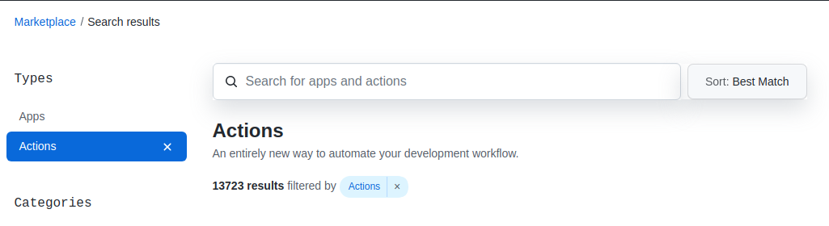
GitHub Actions
Notes:
Currently 13723 actions developed by other developers

Slide 15
GitHub Actions
Github Actions
CI/CD pipelines
Notes:
Currently 13723 actions developed by other developers

Slide 16
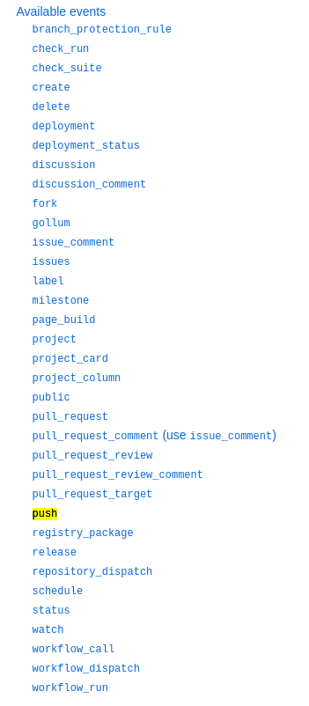
GitHub Actions (Hands-on Prep)
Event driven

Slide 17
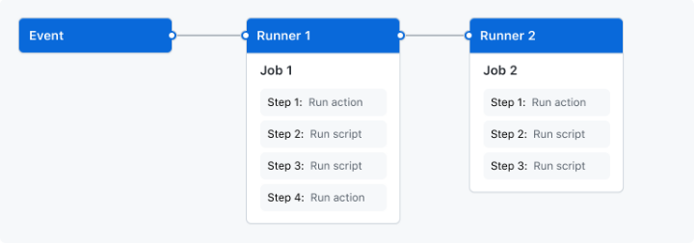
GithHub Actions
Jobs kunnen bestaan uit verschillende steps
Steps worden sequentieel gerund
Steps kunnen een GitHub Action (marketplace) of custom scripts zijn
Er kan data worden uitgewisseld tussen stappen
Jobs runnen parallel (unless otherwise specified)
Elke job heeft z’n eigen VM
VM’s zijn gehost op Runners (MacOS/Linux/Windows or self-hosted)

Slide 18
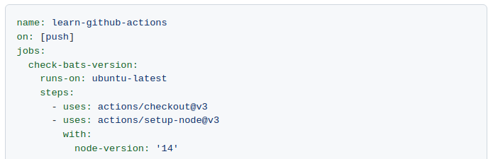
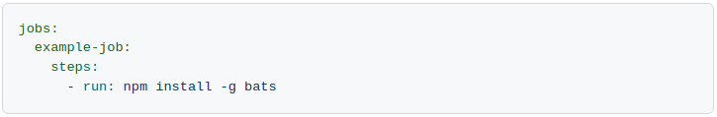
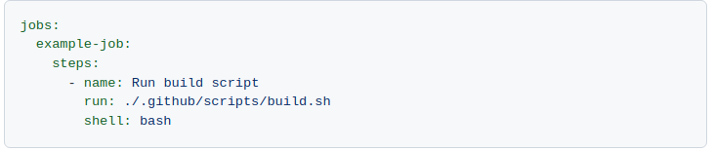
GitHub Actions
Workflows
Een workflow is een set van 1 of meerdere jobs (die bestaan uit 1 of meerdere steps)
Workflows worden gedefineerd in een `.yaml` file in de `.github/workflows/` folder
Running Actions vs. Running Scripts

Slide 19
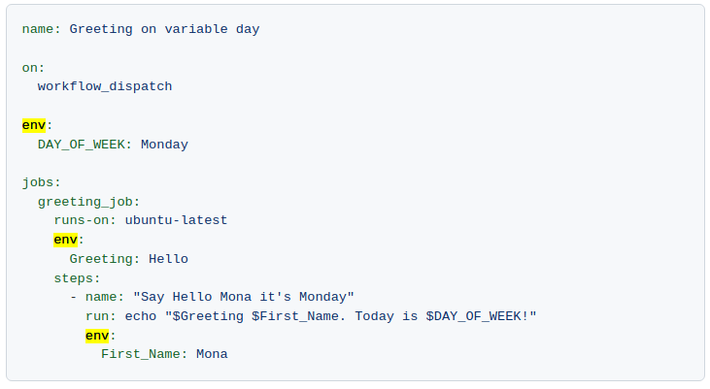
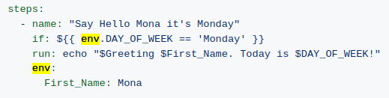
GitHub Actions Environment
Each workflow starts with a fresh environment
Environment variables can be scoped per workflow, job or step

Slide 20
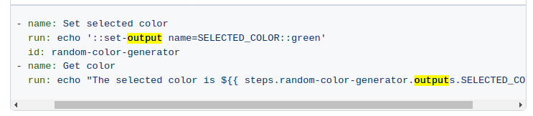
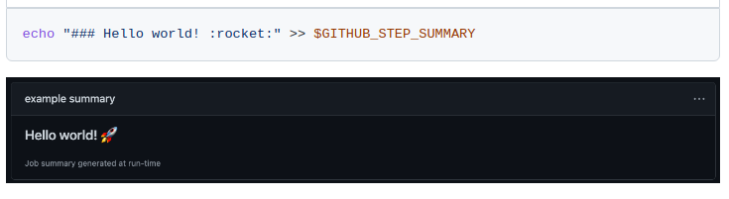
GitHub Actions Environment
You can define outputs per step which can be reused in other steps
Or do fancy stuff as setting a custom step summary or customize your logs
See: https://www.webfx.com/tools/emoji-cheat-sheet/

Slide 21
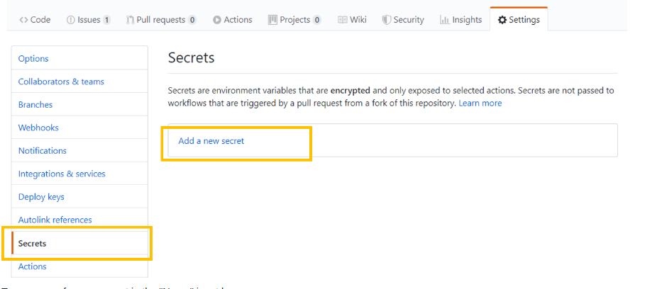
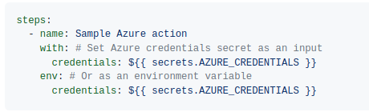
GitHub Actions Secrets
Secrets can be managed on repo-level
See repo → settings → secrets
All secrets can then easily be consumed by the runners of this specific repo

Slide 22
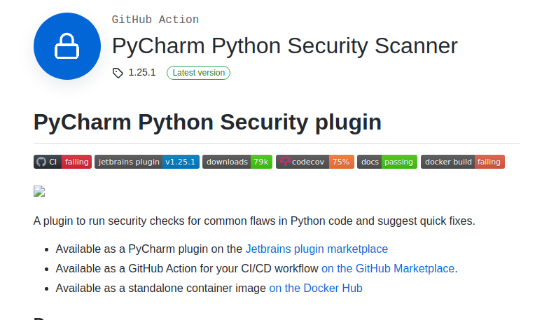
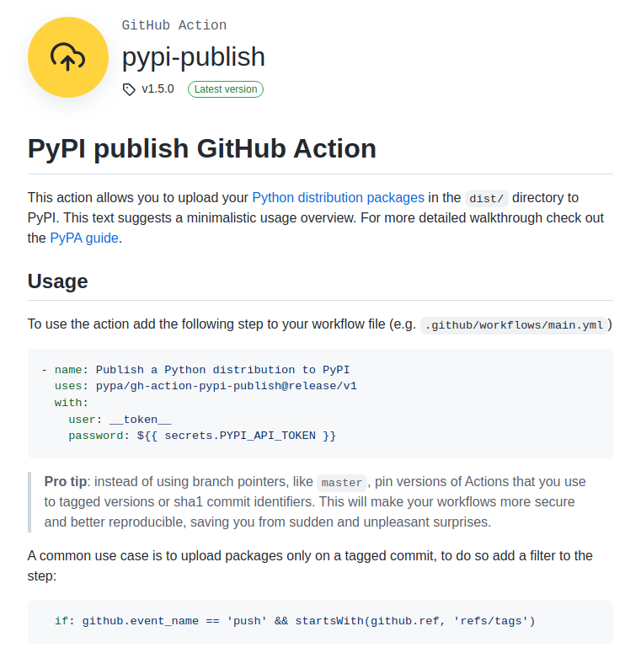
GitHub Actions - Examples

Slide 23
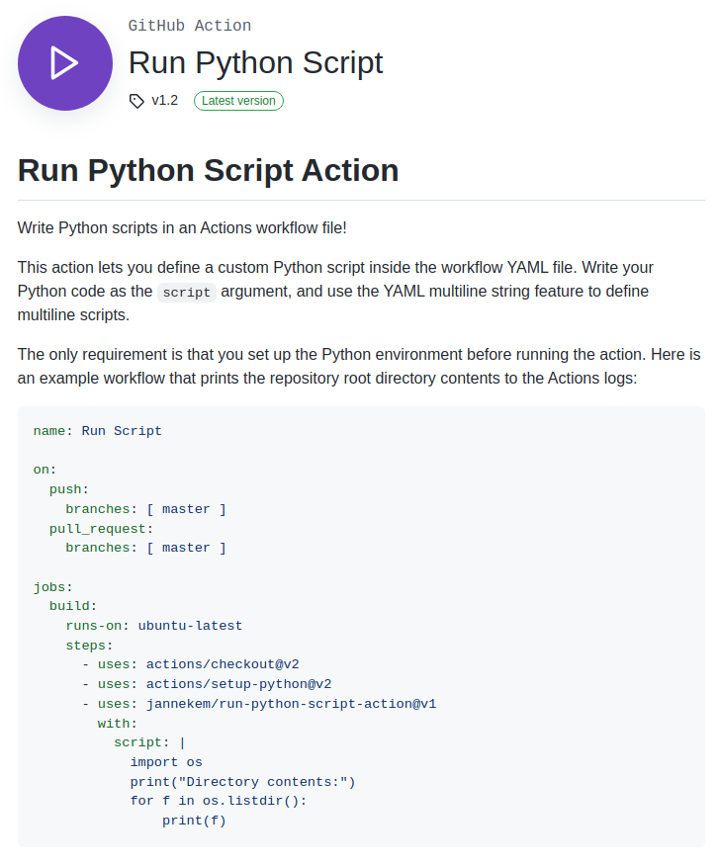
GitHub Actions - Examples

Slide 24
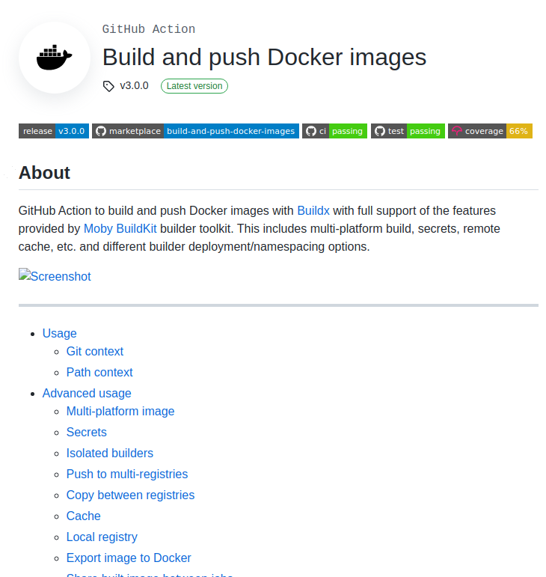
GitHub Actions - Examples

Slide 25
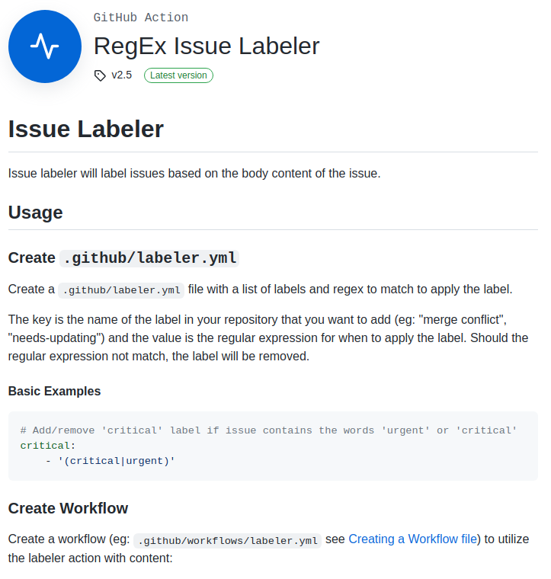
GitHub Actions - Examples

Slide 26
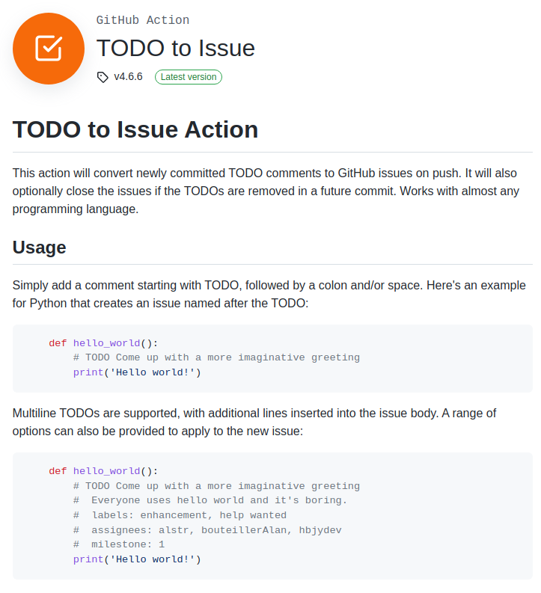
GitHub Actions - Examples

Slide 27
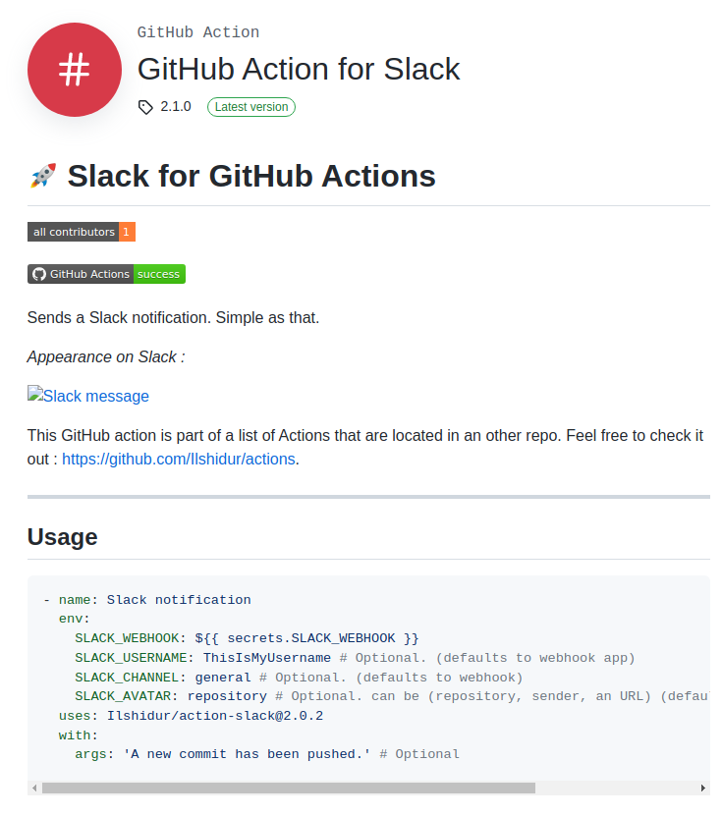
GitHub Actions - Examples

Slide 28
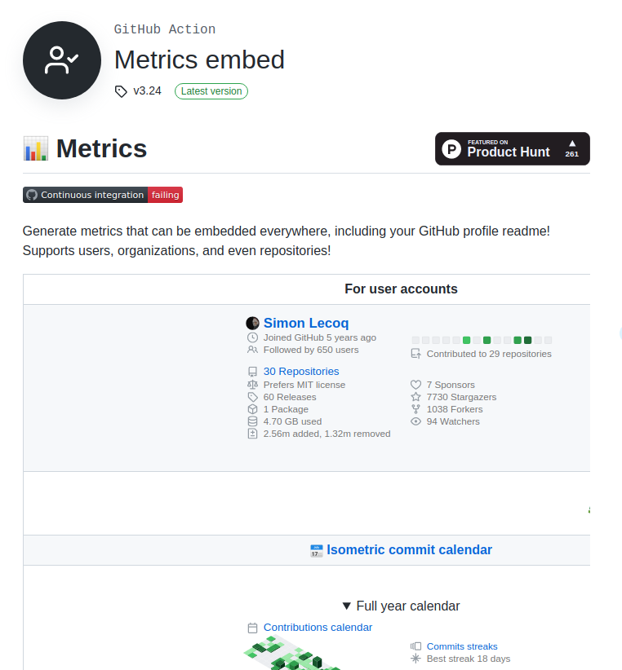
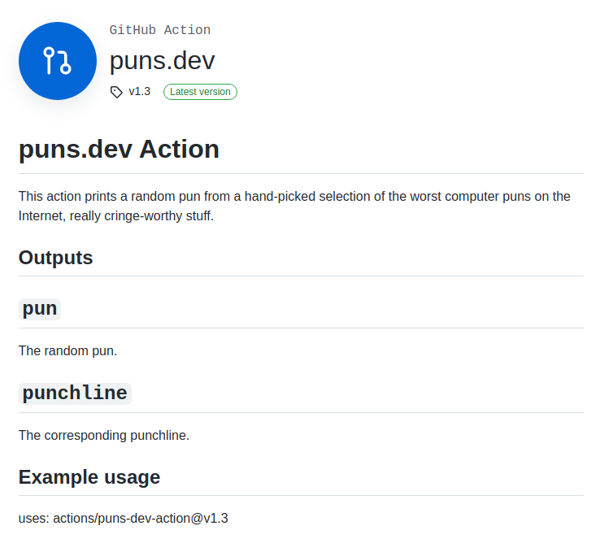
GitHub Actions - Weird Examples

Slide 29
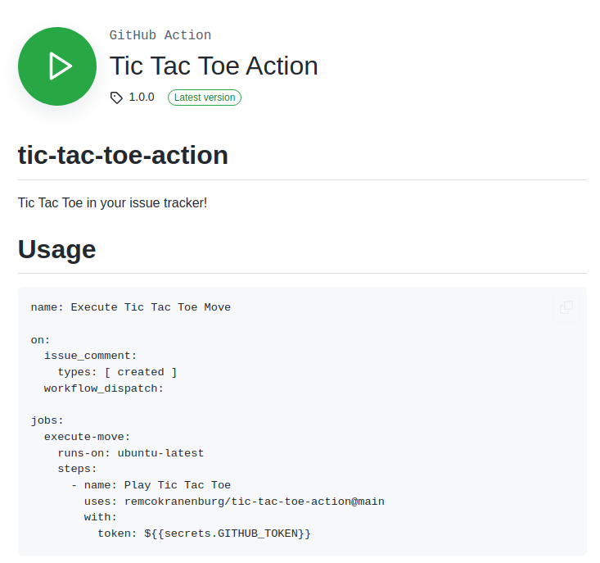
GitHub Actions - Weird Examples

Slide 30
Hands on

Slide 31
CI/CD Training - Dag 2

Slide 32
Programma
“It’s gonna be legen - wait for it - dary.” Barney Stinson
Dag 1
Wat is CI/CD?
Continuous Integration (CI)
Continuous Delivery / Deployment (CD)
Tools
Hands-on
Dag 2
Continue hands-on
Wrap-up hand-on
Vantage CI/CD template
Wrap-up training

Slide 33
CI/CD template
Wie is de product owner?
20/30 min brainstorm -> scope?
Taken verdelen
Bouwen
Notes:
Linting (maar welke? Black/pylint/flake8, wat zijn de config parameters en hoe voegen we die toe zodat ze ook door de ci gebruikt worden
Testing (vast pytest, maar genereren we ook rapporten, kunnen we de output netjes maken in de logs?)
Build (Waar maken we een template voor? builden pypi package, docker build etc.
Deploy step ook binnen scope?
Make file om de stappen lokaal ook uit te kunnen voeren?
Alle randzaken; mail bij falen build, aanpassen MR bij het falen/succesvol zijn, message naar slack etc. allemaal van dat soort randzaken als ze dat willen

Slide 34
Image description (male)

Slide 35

Image description (female)

Slide 36








Design elements

